Slide 1

Mid-West University
Graduate School of Engineering
Central Department of Civil Engineering
Birendranagar-10, Surkhet
Presentation on
Internship Work as an Engineer in Department of Water Supply and Sewerage Management, Surkhet
DATE: 2081/06/15
Presented To:
Central Department of Civil Engineering
Graduate School of Engineering
Mid-West University
Presented By:
Santosh Gautam (2019-71-2-1005-0042)

Slide 2
PRESENTATION OUTLINES
INTRODUCTION
OBJECTIVES AND SCOPE
KEY ACTIVITIES PERFORM
CHALLENGES FACED DURING MY INTERNSHIP
CONCLUSION

Slide 3
INTRODUCTION :
Federal Water Supply and Sewerage Management Project (FWSSMP)
Overview:
Managed by: Department of Water Supply and Sewerage Management (DWSSM)
Focus Areas: Water supply, sanitation services, infrastructure improvement, service delivery, community engagement
Goals: Align with Sustainable Development Goals (SDGs), particularly water and sanitation
Historical Background:
Began in 1895 with BirDhara system in Kathmandu
DWSS established in 1972
Transitioned to Ministry of Housing and Physical Planning in mid-1980s
Dedicated Ministry of Water Supply established in 2018
Coverage (as of July 2018):
Water supply: 87.88%
Sanitation: 99%

Slide 4
OBJECTIVES AND SCOPE
Fundamental Concepts: Understand basic principles of water supply and sewerage systems
Practical Experience: Gain hands-on experience with equipment and procedures
Data Gathering: Learn to collect and analyze data on water quality and flow rates
Public Health & Environment: Recognize the importance of water management
Site Visits: Observe daily operations at water treatment plants and sewerage facilities
Assisting Projects: Support ongoing water supply and sewage management projects
Learning Regulations: Familiarize with laws and regulations in water management
Reporting & Documentation: Assist in preparing reports on water quality and system performance

Slide 5
KEY ACTIVITIES PERFORM
Supervise the construction of a reservoir tank on Bheri Ganga Brihad Khanipani Ayojana, Chhinchu Surkhet
Supervise the construction of a a sedimentation tank and a slow sand filter Taranga Lekhbesi Khanipani Aayojana
Supervise the construction of a slump well Lekhbesi Khanipani Ayojana, Lekhbesi, Surkhet

Slide 6
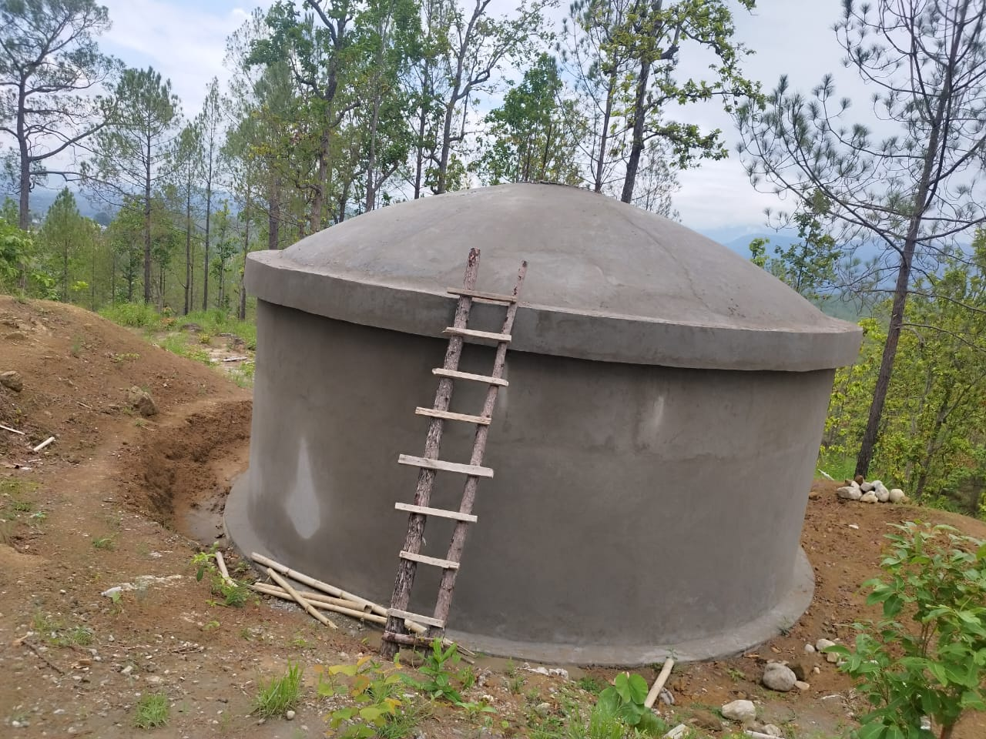
Supervise the construction of a reservoir tank on Bheri Ganga Brihad Khanipani Ayojana
Tasks:
Reviewed engineering designs
Monitored site preparation and construction
Ensured materials met safety standards
Collaborated with engineers and contractors
Enhanced technical knowledge and problem-solving skills
Specifications and Details:
Tank Type: Circular reinforced concrete ground-level reservoir
Capacity: 150 cubic meters (150,000 liters)
Fig 1: Construction of Reservoir Tank at Bheri Ganga, Chhinchu Surkhet
Continued……..

Slide 7
Dimensions:
Diameter: 4 meters
Height: 12 meters
Construction Materials:
Concrete: Grade 25 for structural elements
Reinforcement: High-tensile steel bars, minimum yield strength 500 MPa
Water-proofing: Internal walls
Inlet/Outlet Pipes:
Inlet: 300mm diameter steel pipe
Outlet: 400mm diameter steel pipe
Overflow: 200mm diameter with corrosion-resistant coating
Appurtenances:
Access manholes, 600mm diameter with lockable covers

Slide 8
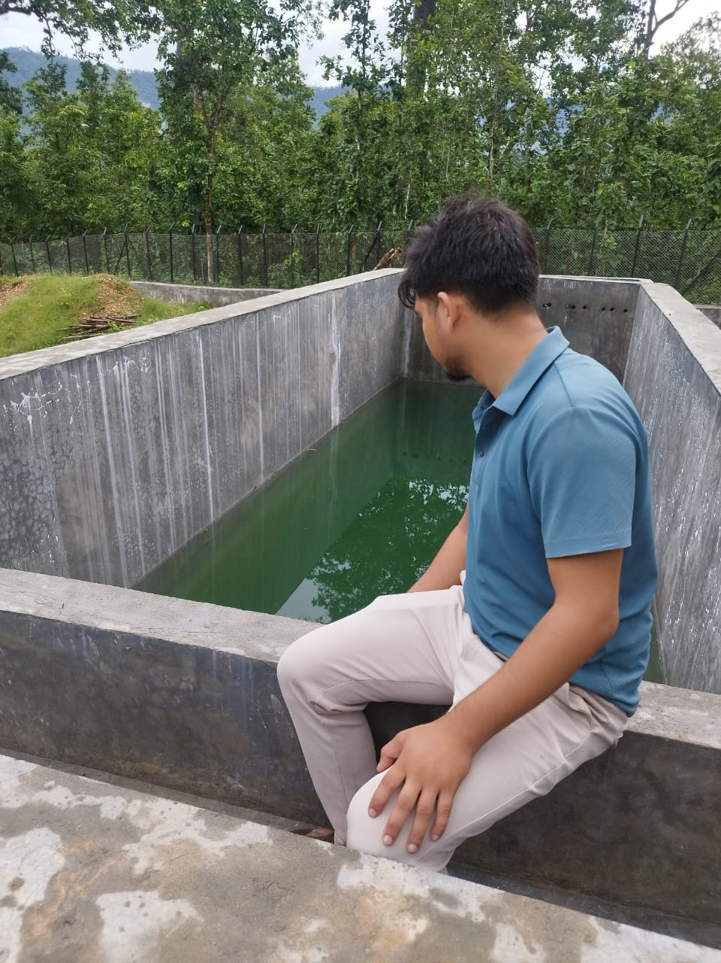
Supervise the construction of a a sedimentation tank and a slow sand filter Taranga Lekhbesi
Sedimentation Tank Specifications:
Type: Horizontal flow rectangular tank
Capacity: 500 cubic meters/day
Dimensions: 9m (L) x 3.5m (W) x 2.7m (D)
Retention Time: 2 to 4 hours
Inlet/Outlet: Baffled inlet, weir-type overflow
Sludge Collection: Sloping floor to central hopper, manual/automated removal
Materials: Reinforced concrete (Grade 25), corrosion-resistant steel/PVC
Coating: Epoxy-based waterproof coating
Fig 2: Sedimentation Tank
Continued……..

Slide 9
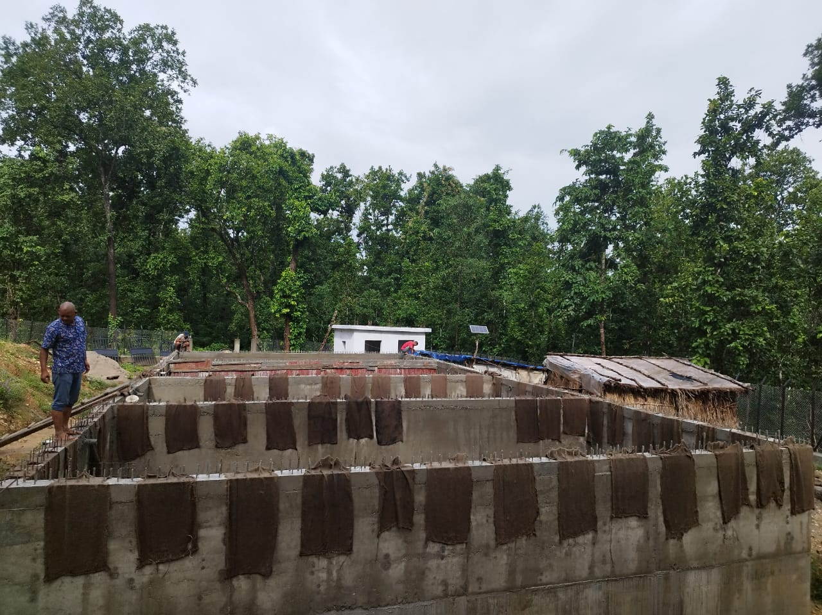
Slow Sand Filter Specifications:
Type: Open gravity flow system
Filter Bed Area: 36 sq. meters (9m x 4m)
Filter Layers:
Top Sand Layer: Fine sand (0.15-0.35 mm), 0.8-1.2m thick
Intermediate Layer: Coarse sand (0.5-1.0 mm), 0.15m thick
Gravel Support Layer: Rounded gravel (2-6 mm), 0.3m thick
Inlet/Outlet: Baffled inlet, piped outlet with flow control
Filtration Depth: ~1.5 meters
Drainage System: Perforated pipes under gravel layer
Cleaning Method: Periodic scraping of top sand layer
Materials: Reinforced concrete, corrosion-resistant piping/valves
Standards: WHO guidelines for drinking water quality
Fig 3 : Slow Sand Filter

Slide 10
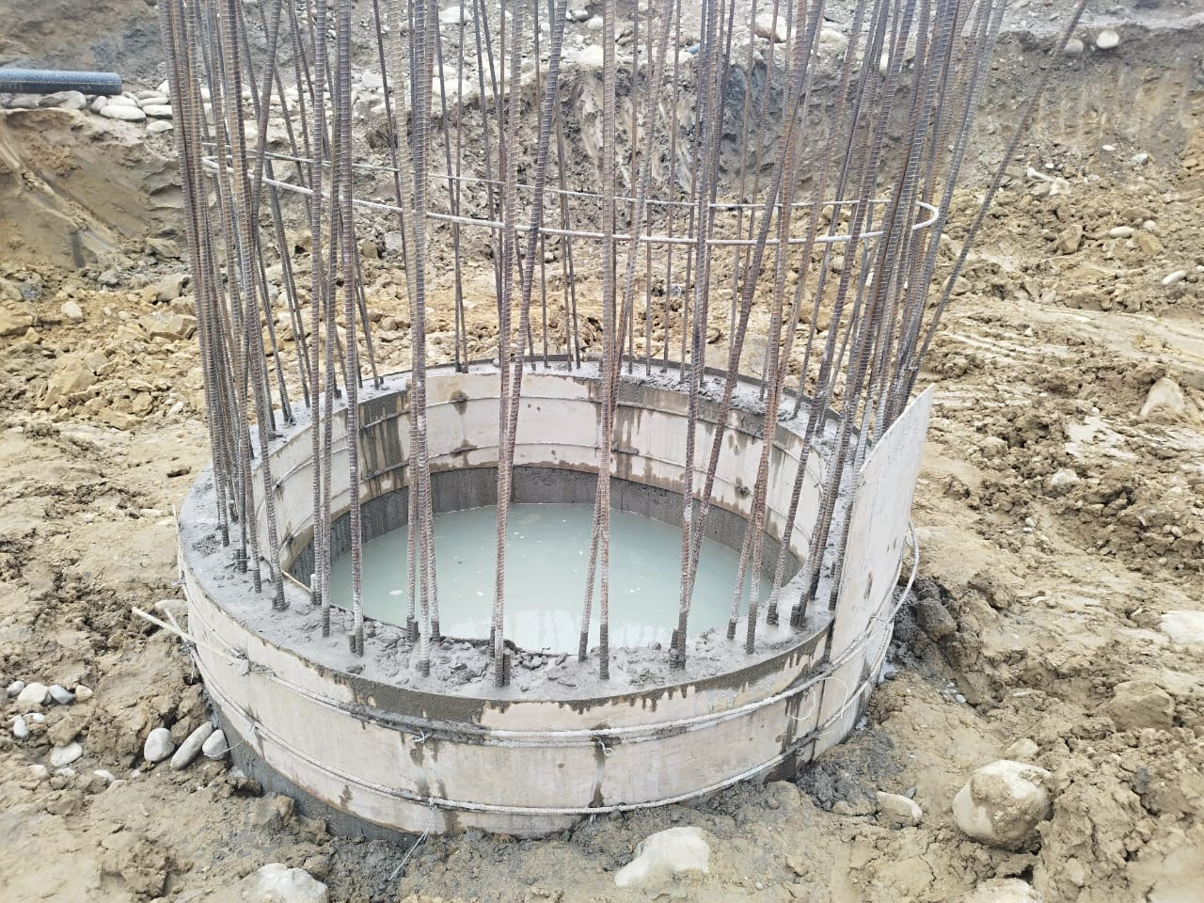
Supervise the construction of a slump well Lekhbesi Khanipani Ayojana, Lekhbesi
Slump Well Specifications:
Well Diameter:
Inside Diameter: 1.5 to 2.5 meters
Depth: 6 to 10 meters
Materials:
Well-Lining: Reinforced concrete rings or masonry (150-200mm thick)
Concrete Grade: M20 or M25
Reinforcement: 12mm steel bars, spaced 150-200mm center to center
Filter Media:
Gravel Filter Layer: 100-150mm thick
Geo-textile Fabric: Optional
Fig 4: Slump Well starting phase
Continued……..

Slide 11
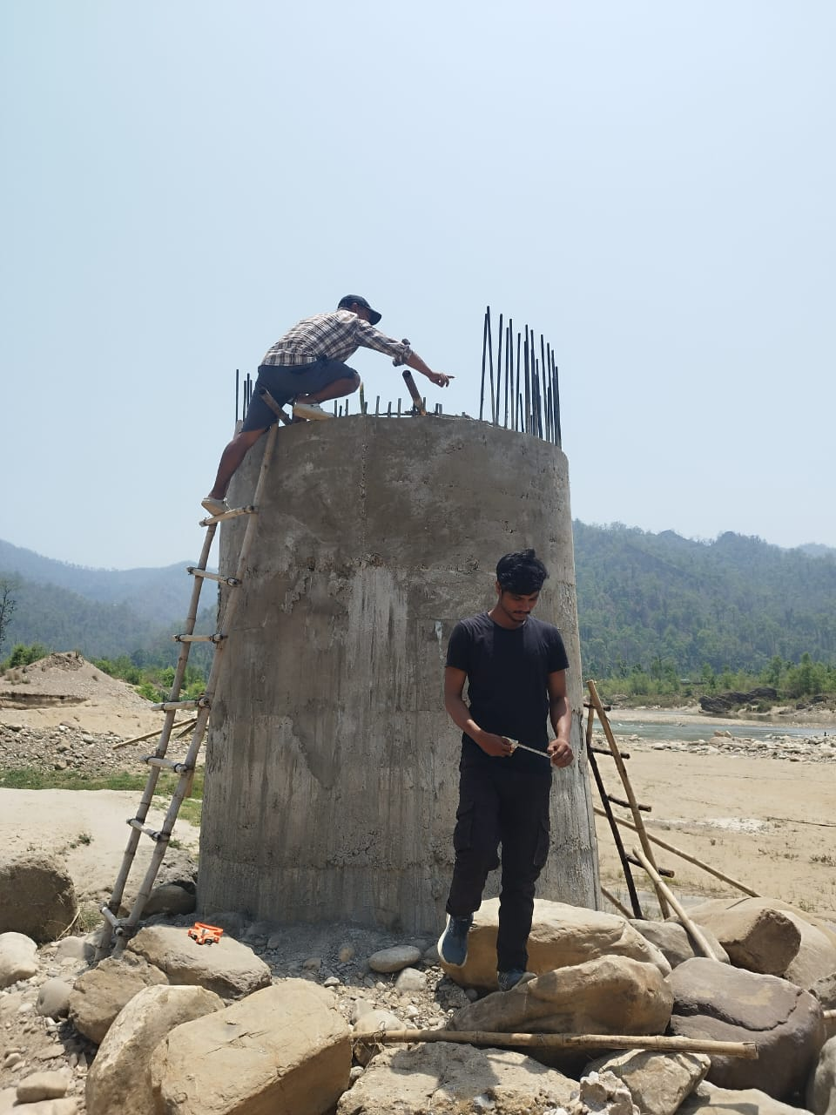
Pumping Equipment:
Submersible Pump: 5 HP to 10 HP
Pump Discharge Pipe: 100mm diameter PVC or GI pipe
Well Cover:
Heavy-duty, cast iron or RCC cover
Drainage System:
Connection to stormwater drains or water treatment systems
Safety Features:
Guardrails, warning signs, and proper fencing
Maintenance Access:
Access points for maintenance and inspection
Fig 5: Slump Well

Slide 12
CHALLENGES FACED AND OVERCOME DURING MY INTERNSHIP
Site Accessibility: Difficult terrain hinders material transport.
Weather Delays: Extreme conditions affect work quality.
Groundwater Issues: High water tables complicate excavation.
Utility Conflicts: Existing underground lines obstruct work.
Material Delays: Shortages slow project progress.
Safety Risks: Inadequate measures endanger workers.
Permit Delays: Slow approvals from authorities stall projects.
Community Impact: Disruptions to local traffic and life.
Equipment Failures: Breakdowns hinder operations.
Labor Shortages: Lack of skilled workers delays progress.
Design Changes: Unforeseen conditions require modifications.
Environmental Compliance: Adhering to regulations is crucial.

Slide 13
CONCLUSION
My internship on the water supply system project in Surkhet was a pivotal experience that enriched my understanding of civil engineering. I gained hands-on knowledge in planning, design, and execution while navigating challenges such as site accessibility and weather conditions. This opportunity honed my skills in water distribution networks, site management, and teamwork, ultimately preparing me for future professional challenges in infrastructure development. The lessons learned will serve as a strong foundation as I advance in my career.

